Slide 1




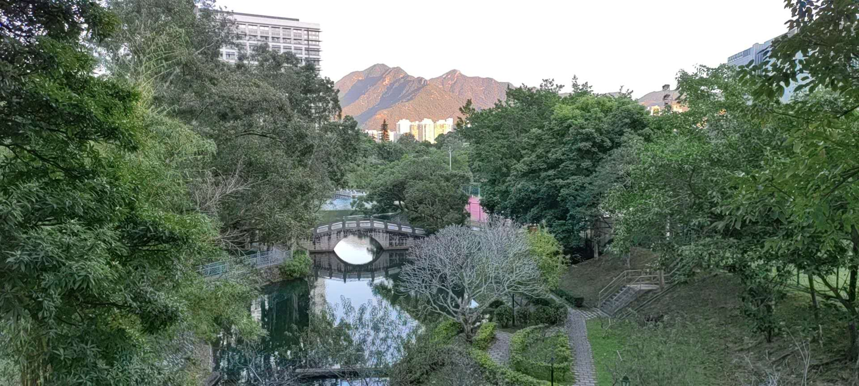
Lecture 4: Low-Rank Decomposition
Feng-Lei Fan (FAN: Frontier of Artificial Networks)
Assistant Professor, City University of Hong Kong

Slide 2
Acknowledgement
These slides contain materials developed by
Bei Yu: https://www.cse.cuhk.edu.hk/~byu/CMSC5743/2021Fall/slides/Lec04-decomp.pdf
Anton Rodomanov
https://bayesgroup.github.io/team/arodomanov/tt_hse16_slides.pdf
https://www.youtube.com/watch?v=V_ugq2iIjxE
Outline

Slide 3
Outline
Quantization and Universal Approximation
Tensor Decomposition
Low-rank Decomposition
Outline

Slide 4
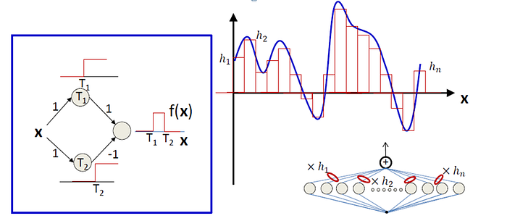
Universal Approximation
Neural networks with a certain structure can, in principle, approximate any continuous function to any desired degree of accuracy.
Outline

Slide 5
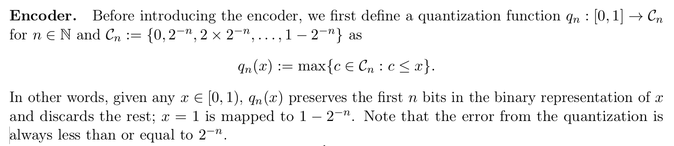
Encoder

Slide 6
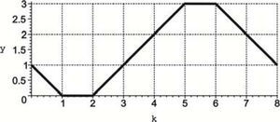
Memorizer

Slide 7
Outline
Quantization and Universal Approximation
Tensor Decomposition
Low-rank Decomposition
Outline

Slide 8
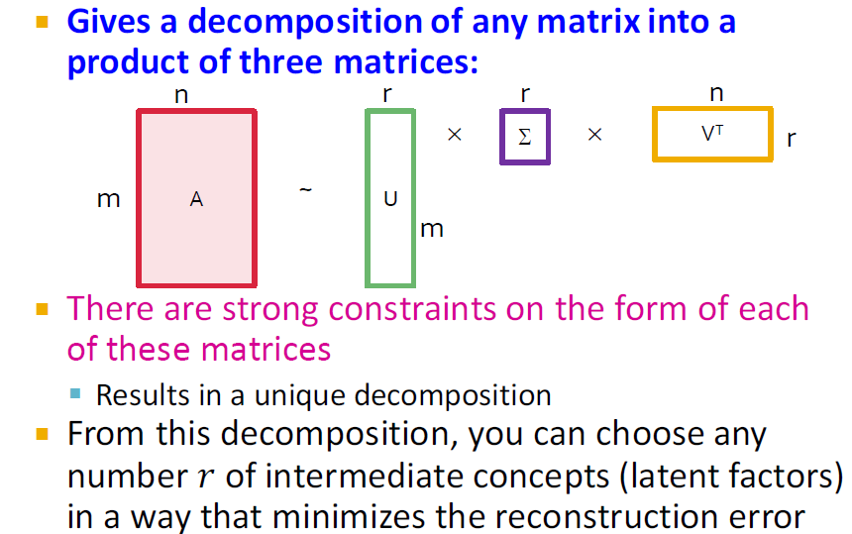
Reducing Matrix Dimension

Slide 9
Different Decomposition Methods
SVD
CP Decomposition for Tensors
Tucker Decomposition for Tensors
Tensor Train

Slide 10
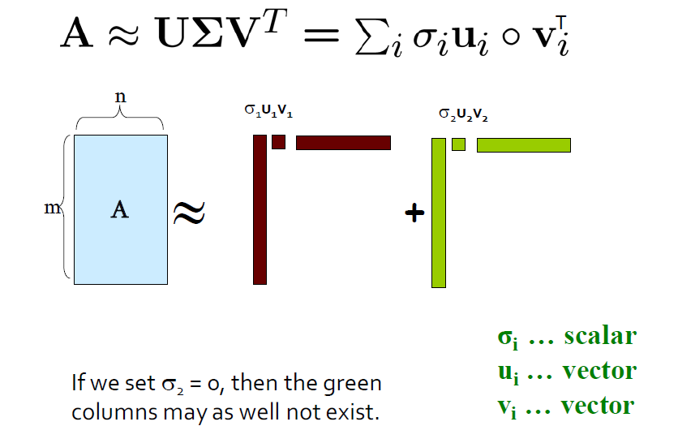
SVD

Slide 11
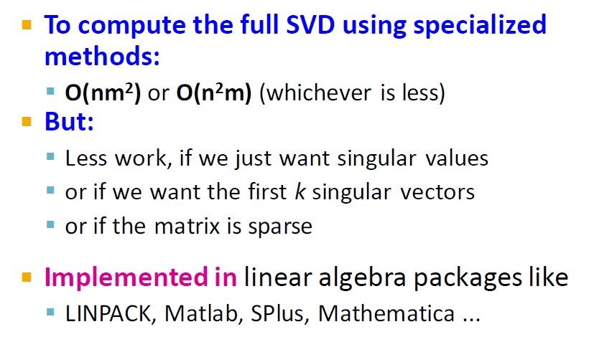
Complexity

Slide 12


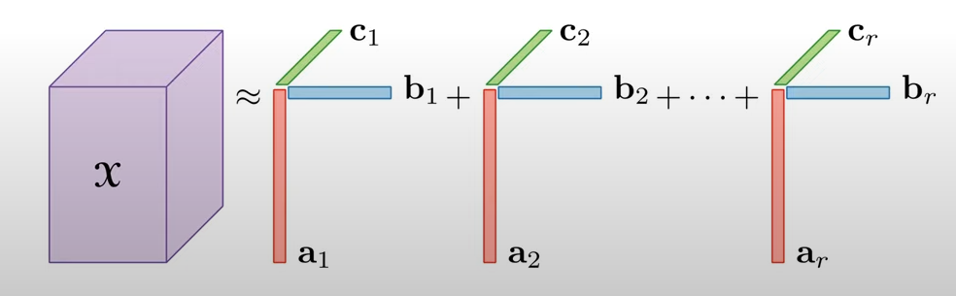
CP Decomposition

Slide 13
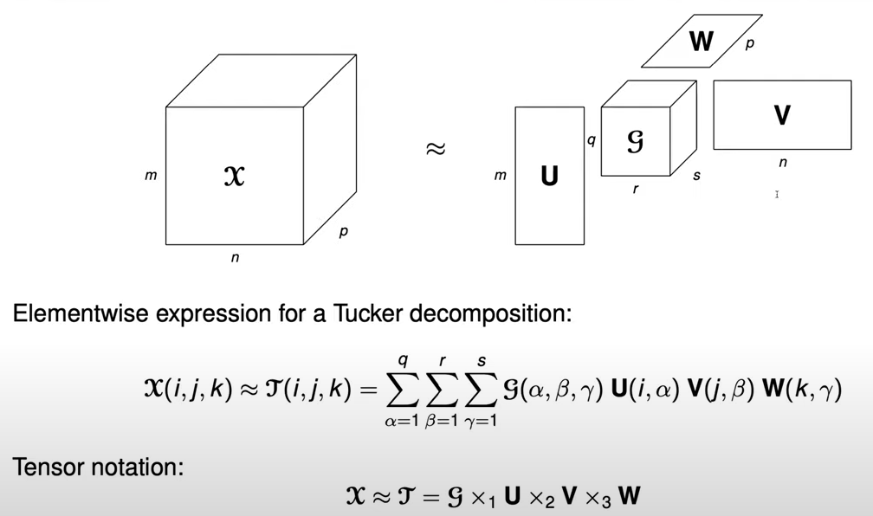
Tucker Decomposition

Slide 14
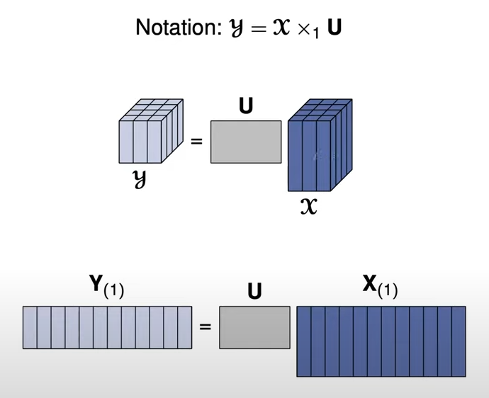
Tucker Decomposition

Slide 15
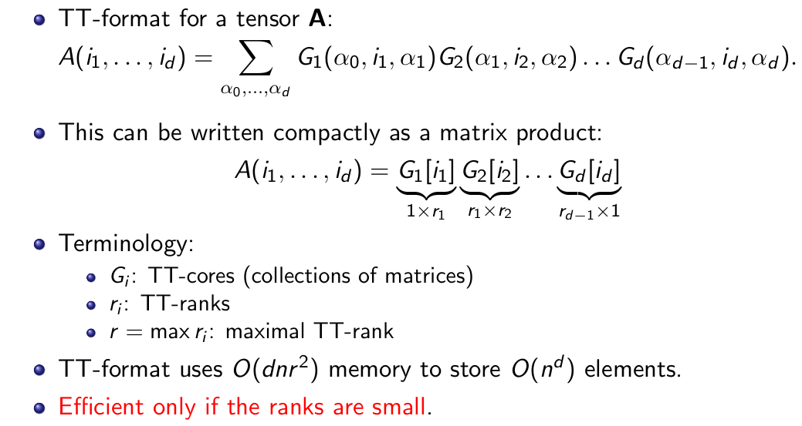
Tensor-Train Decomposition

Slide 16
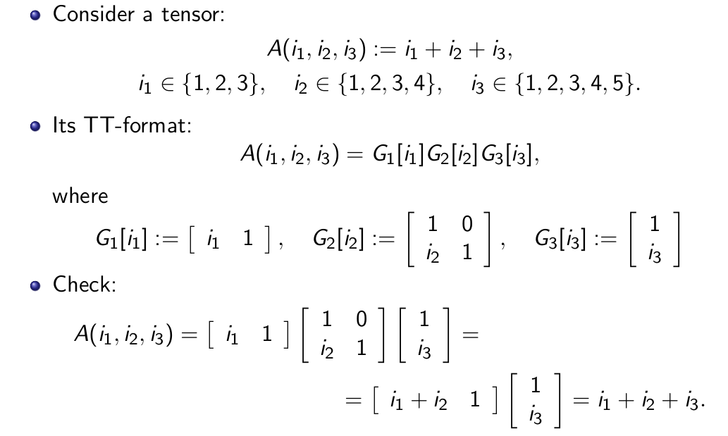
Tensor-Train Decomposition

Slide 17
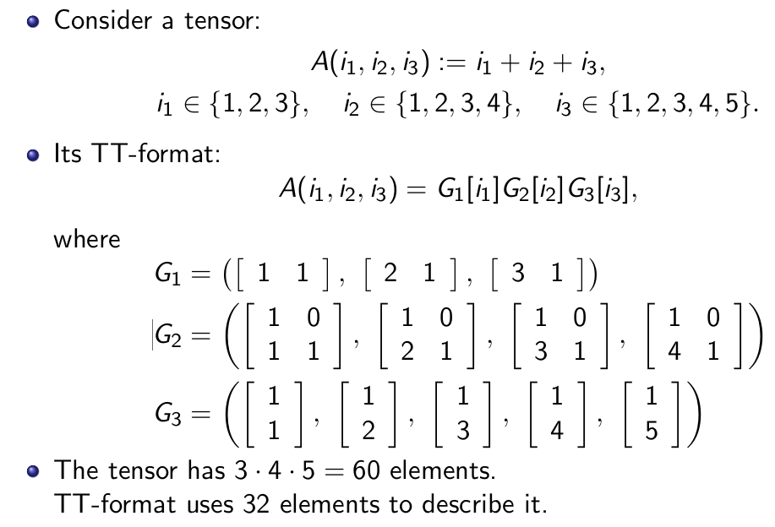
Tensor-Train Decomposition

Slide 18
Outline
Quantization and Universal Approximation
Tensor Decomposition
Low-rank Decomposition
Outline

Slide 19
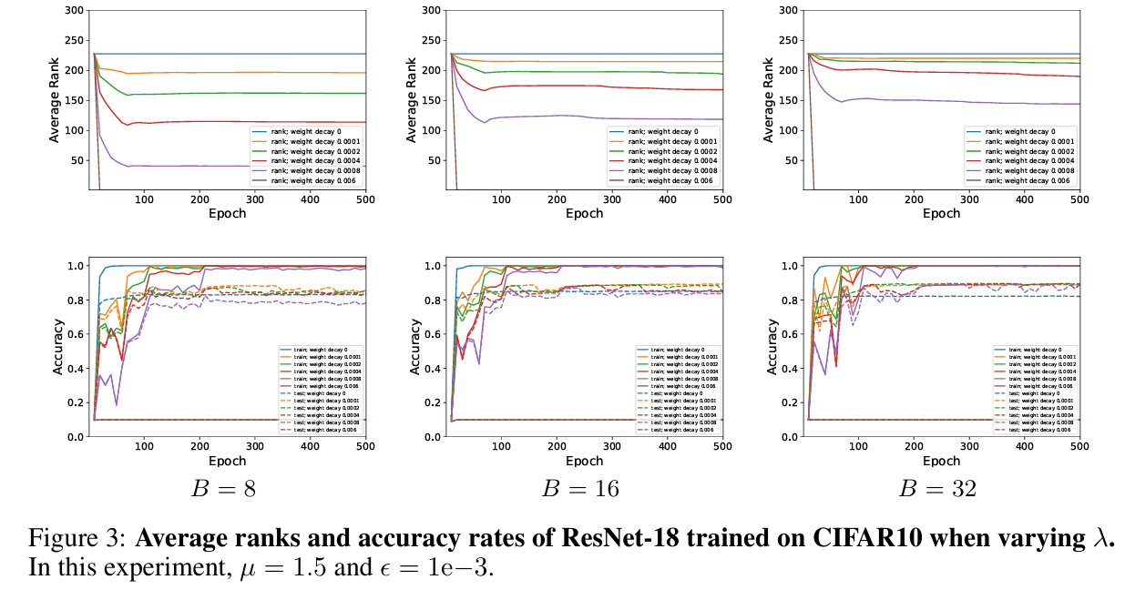
Are Weight Matrices Low-rank?
SGD and Weight Decay Secretly Minimize the Rank of Your Neural Network

Slide 20
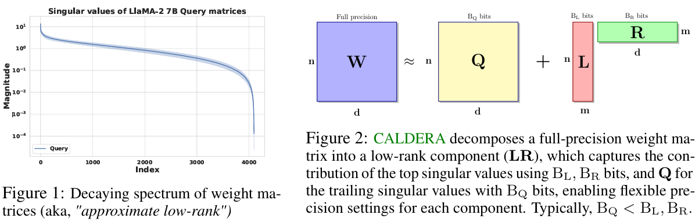
Model Compression via Decomposition
https://arxiv.org/pdf/2405.18886

Slide 21
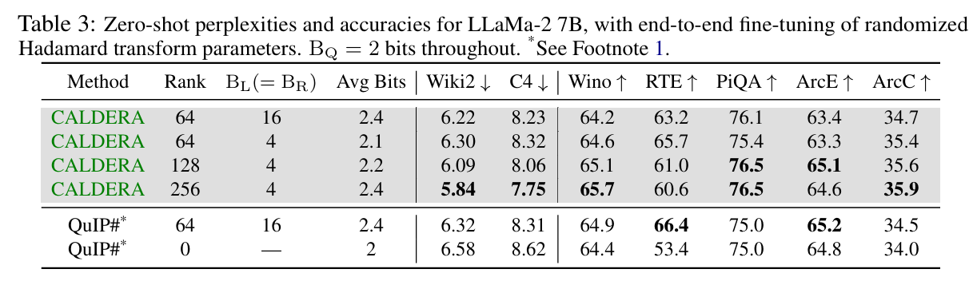
Model Compression via Decomposition
https://arxiv.org/pdf/2405.18886

Slide 22
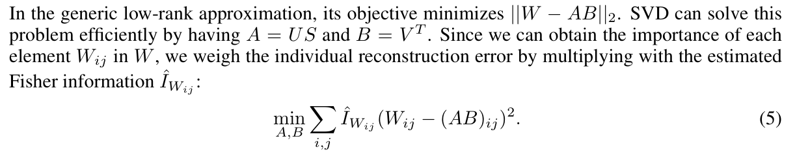
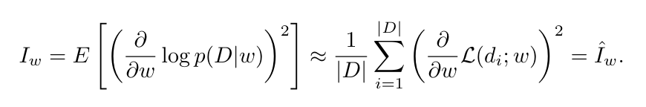
Weighted Low-rank Decomposition
https://arxiv.org/pdf/2207.00112

Slide 23
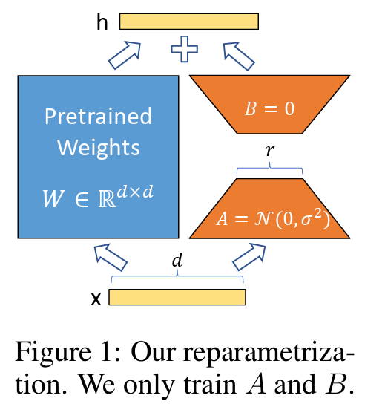
Low-rank Adaptation
Task-switching
More efficient
No latency when deployed
https://arxiv.org/abs/2106.09685

Slide 24



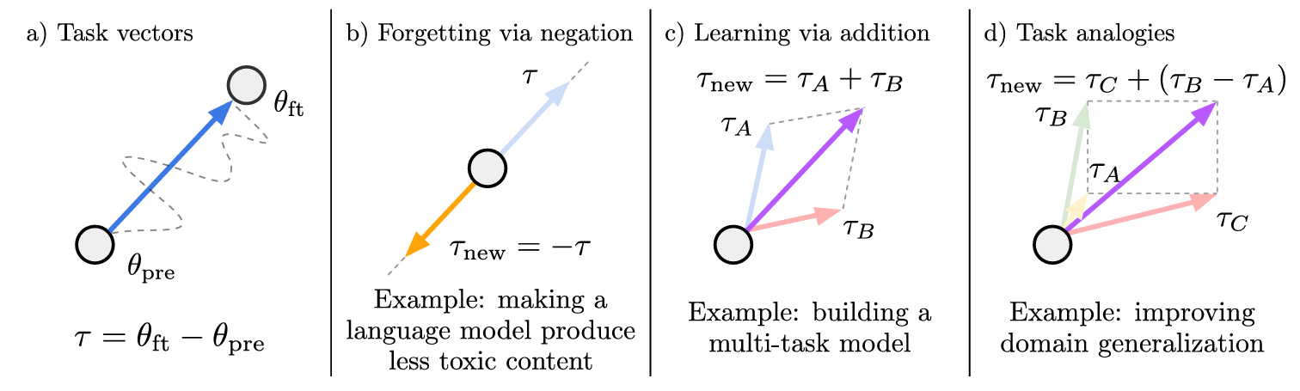
Model Compression via Task Arithmetic
Task A
Task B
Task A+B
Ilharco et al. EDITING MODELS WITH TASK ARITHMETIC, ICLR 2023.

